Slide 1
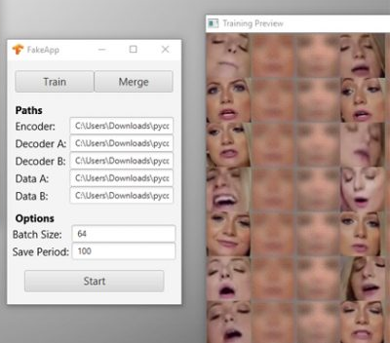
DeepFake Detection
Zhuoli Xu 29788455
Yuntao Yang 29712068
Yuhao Ye 29730341
Yipeng Shen 29305268
Allocation
Yuhao Ye : Overview structure of detection, Possible weakness analysis, Pre-processing (including Haar), Demo.
Yuntao Yang : Processing after Extraction, Demo for Merging Techs.
Yipeng Shen : Technical details in deepfakes detector, in both Variance calculation and Skin detector methods.
Zhuoli Xu : DeepFake model, face swap and analysis.

Slide 2
Content
Introduction of DeepFake
Problem: Detect Deepfake, Related Ethical Issues
Demo
Solutions
Conclusion

Slide 3
What is DeepFake
?

Slide 4
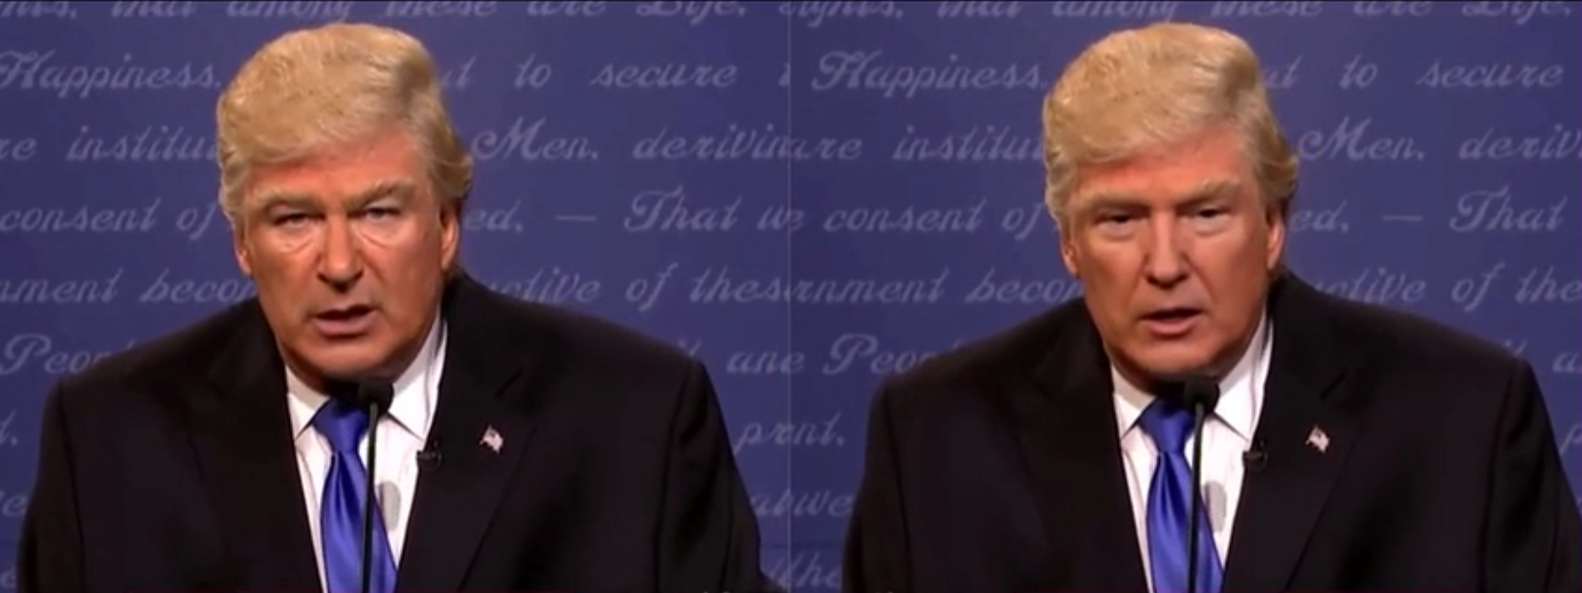
Which one is the fake one?

Slide 5
Original
Deepfake

Slide 6
Problems
Ethical issues
Hard to distinguish and detect
Create confusion by passing off the spurious as genuine
Fake celebrity porn
Harmful to their reputation
Bad effects on the teenagers
Fake news
Disseminating false information
Misleading the society

Slide 7
How to detect the deepfakes
?

Slide 8
DeepFake Principle
?

Slide 9
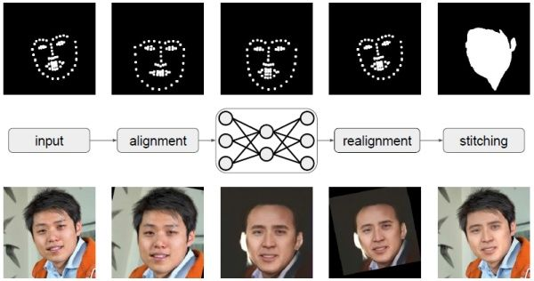
DeepFake Model
image A
image B
DeepFake

Slide 10
Encoder - Decoder
One encoder, two decoders (one for image A, the other for image B)
Encoder:
5x5 convolution kernel
alpha=0.1 LeakRelu (activation function)
Decoders:
Convolution and PixelShuffer for sampling
4x4,8x8 … 64x64 reconstructing by gradually increasing the resolution(similar to U-net structure)

Slide 11
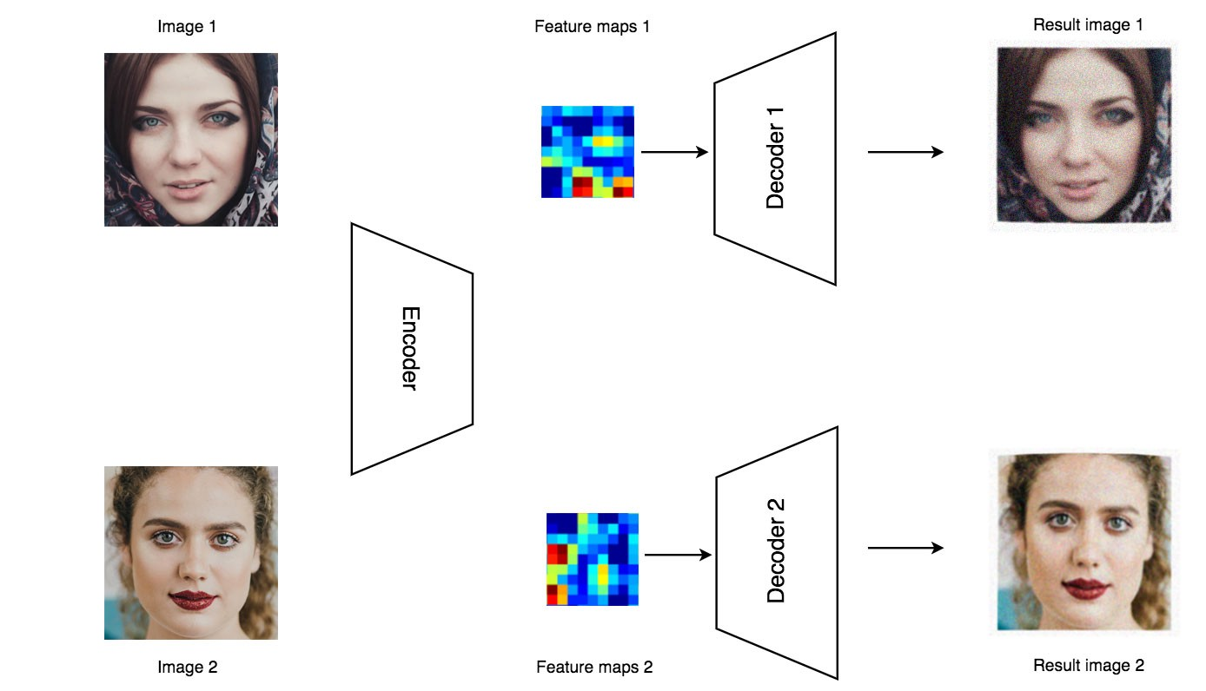

Slide 12
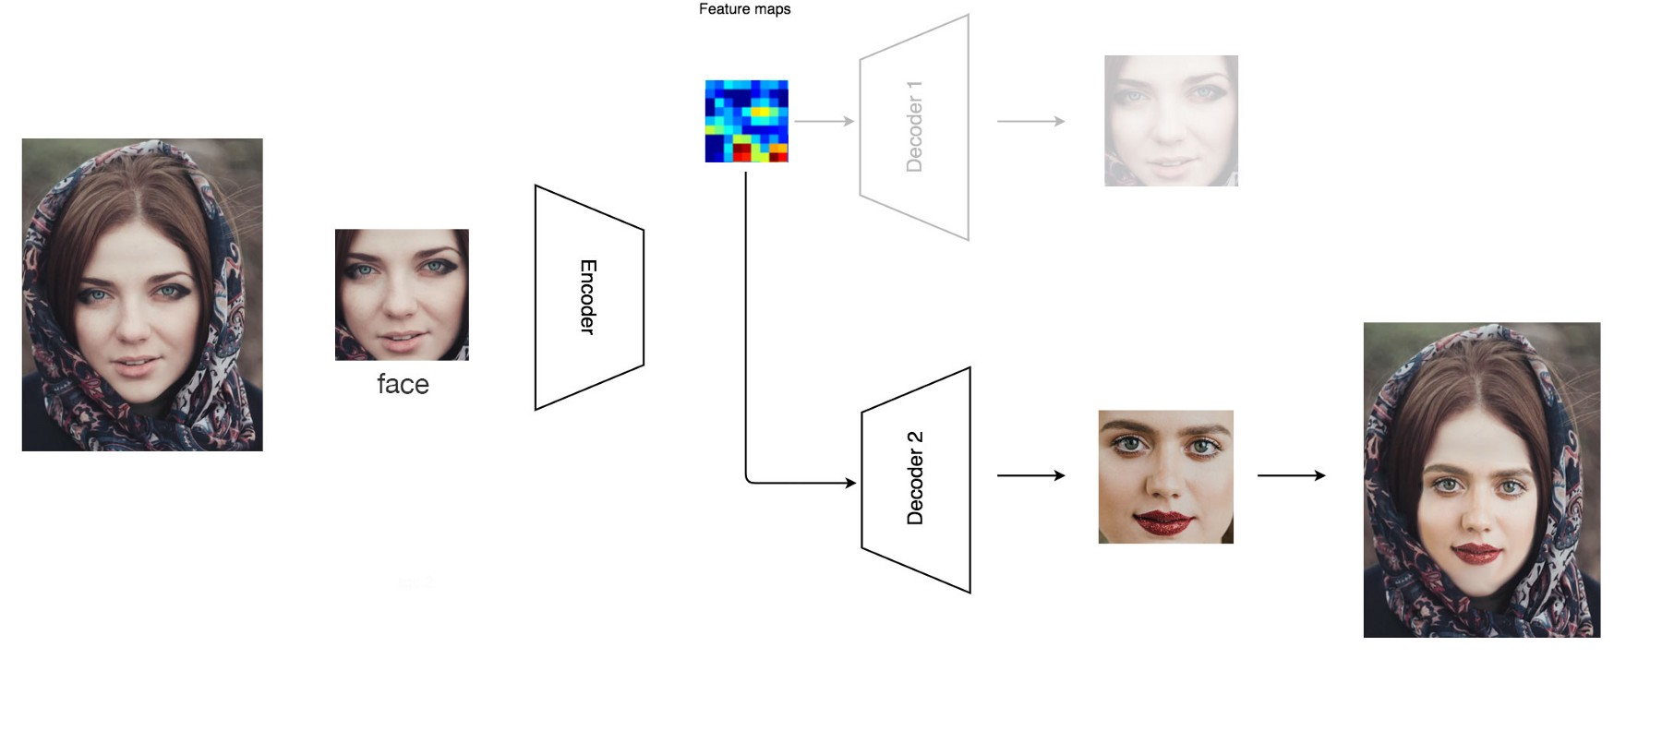

Slide 13
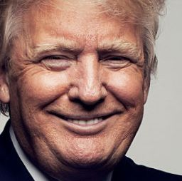
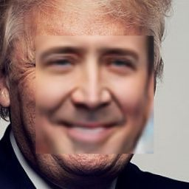
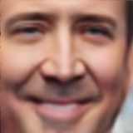
Processing after Extraction
*Reasons:
<a> Objective differences
<b> highly relative to the size of training sets
-->> large, high computing resources requirement
-->> small, unsatisfactory learning results
<c> Caused both by reasons <a> & <b>
*Solutions:
<1> For edges : smaller faces -->> decrease the resolution
<2> For all 3 issues : image merging techs
(optional -> skin colour detection)
*There will be 3 main problems after face swaping：
<a>differences in colours of skin
<b>differences in illumination
<c>fake faces have obvious edges

Slide 14
Image Merging Techs
Skin Colour Detection
<a> smooth_mask
Hard to make blurry to clear,but easy to make clear to blurry
>>>> Apply Gaussian Blur to edge region of orginal image
<b> adjust_avg_color
Add a adjustment value to orignal image
>>>> Pi = Pi + δp , δp = avg(|Pi-Pr|)
Pi -- the original value
Pr -- the pixel value of the replacement figure
<c> Poisson Merging
The method from Poisson Image Editing
A back-up and replacement of face feature detection
One possible soulutin in RGB space:
if (R>G) and (R>B) and |R - G| > 15 :
if (R > 95) and (G > 40) and (B > 20) and (max(R, G, B) - min(R, G, B) > 15):
pixel = skin;
else if (R > 220) and (G > 210) and (B > 170):
pixel = skin;

Slide 15
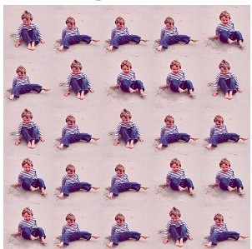
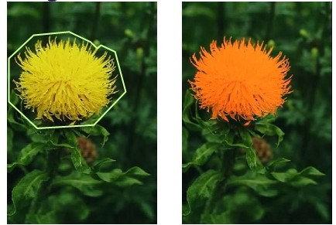
Poisson Image Editing
Seamless Tiling
Colour Change

Slide 16
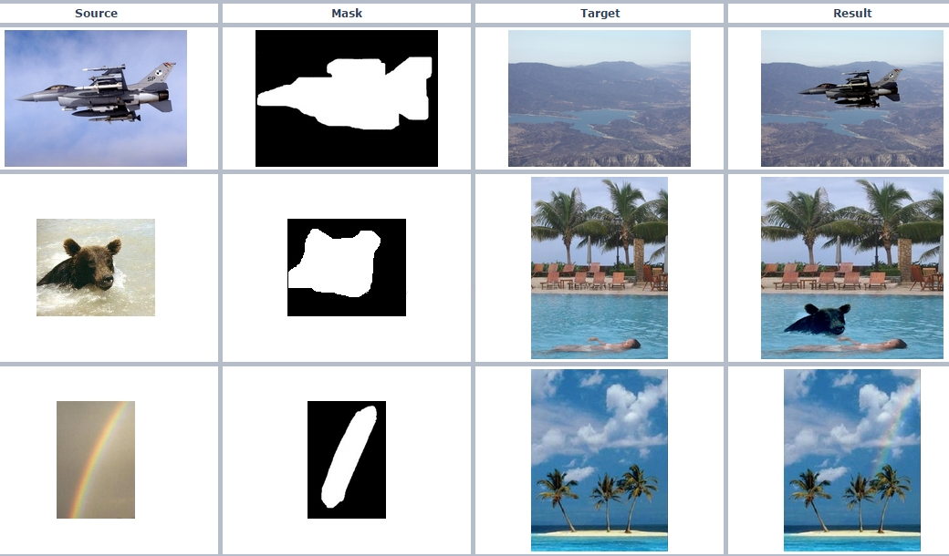
Poisson Image Editing
Merging

Slide 17
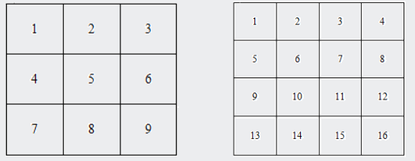
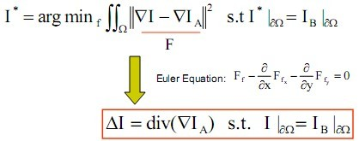
Poisson Image Merging
To Reconstruct (solve the divergences):
[V(2)+V(5)+V(7)+V(10)]-4*V(6)=div(6)
[V(3)+V(6)+V(8)+V(11)]-4*V(7)=div(7)
[V(6)+V(9)+V(11)+V(14)]-4*V(10)=div(10)
[V(7)+V(10)+V(12)+V(15)]-4*V(11)=div(11)
Constraint Equations:
V(1)=u(1) V(2)=u(2) V(3)=u(3)
V(4)=u(4) V(5)=u(5) V(8)=u(8)
V(9)=u(9) V(12)=u(12) V(13)=u(13)
V(14)=u(14) V(15)=u(15) V(16)=u(16)
div(5)=[V(2)+V(4)+V(6)+V(8)]-4*V(5)

Slide 18
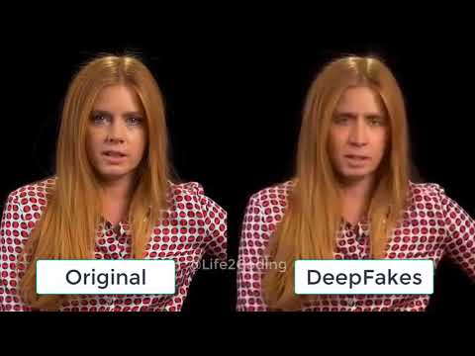
Original DeepFake Video
Notes:
hi everyone, my name is yuhao ye. yipeng and me are in charge of the detection part of DeepFake. As you can see in this deepfake video. Left one robert downey is the real actor of marvel’s movie iron man, and right one guy is the iron man from Silicon Valley elon musk. Deepfake swap downey’s face by elon musk. If you only watch the right one video, you might not realize you are watching a fake video edited by deepfake

Slide 19
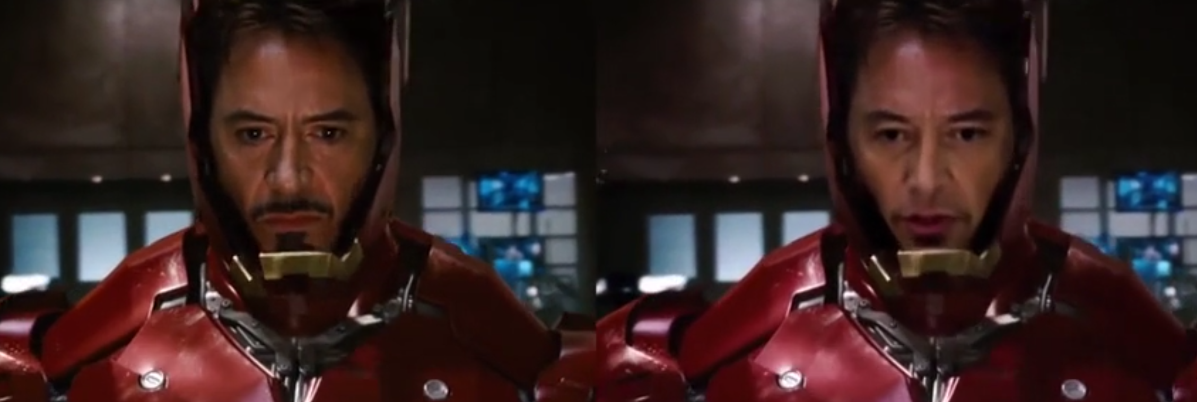
DeepFake Detection
Possible Weakness:
1. Shadow
2. Splicing [1]
3. Blur
General fake(edited) picture detection
Notes:
here list three possible weakness we can breakthrough for detecting deep fake
we do some research on those three things, and find that first two belongs to General fake picture detection edited by
some image-editing softwares like Adobe Photoshop
after compare with first two, we find blur detection is the more convenient and efficient way to detect deepfake

Slide 20
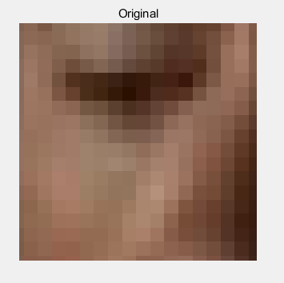
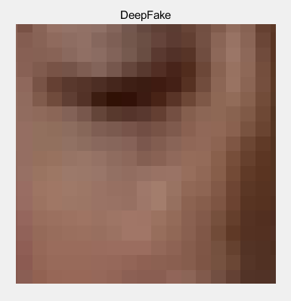
Original face have more levels of colour than deepfake
Notes:
here shows the reason for doing blur detetion. if zoom in face region to pixel level like shown in the picture. you will find original face have more levels of colour than deepfake like shown in rectangle region which means original face have more details than deepfake. Because blur make deepfake face loss details

Slide 21
Main Process of Detection
Read in video stream
Locate face region -- Haar casecade classifier
Convolve with Laplacian operator -- Amplify difference of variance
Calculate variance for face region
Split into two cases
Case1:
Two videos (one is original)
Case2:
One unknown video
Locate another reference region based on face region
Calculate variance for reference region
Calculate the ration (face/reference)
Compare ratio with a threshold
Above threshold>>>>Original
Below threshold>>>>DeepFake
Compare two face regions’ variances
Bigger one is original
Smaller one is DeepFake

Slide 22
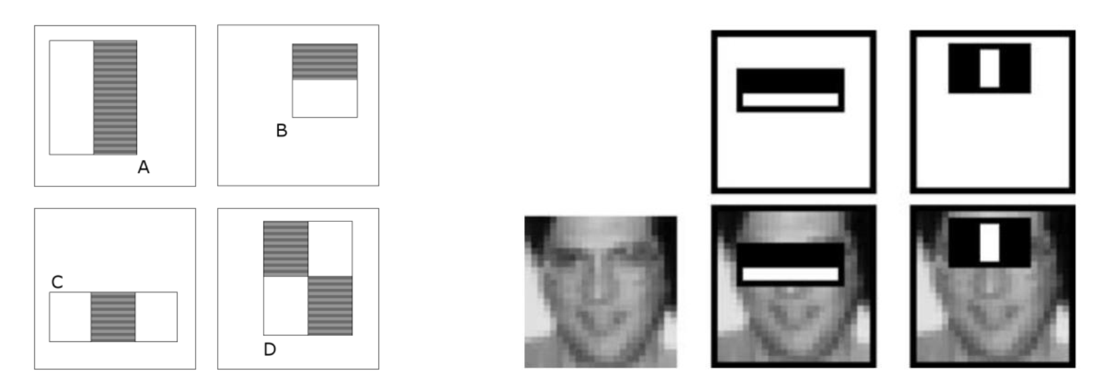
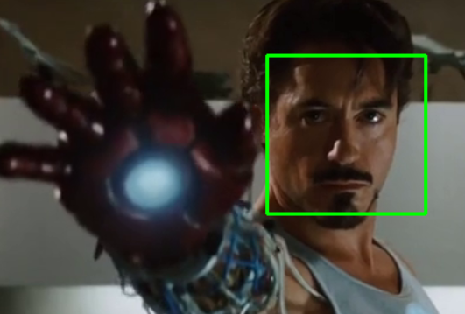
Haar Cascade Classifier
Theory:
Integral Image can speed up the haar-like rectangle features mentioned above.
AdaBoost can boost the performance of classification.
Implementing Haar by Opencv (Python)
w
Convert frames into grayscale
Use pre-trained Haar classifier in opencv library(cv2.CascadeClassifier)
Classification
Return a list including coordinates for face region in format [x,y,w,h]
(x,y) is upper left point, w refers to width, h refers to height
Crop face region for calculating variance
(x,y)
h

Slide 23
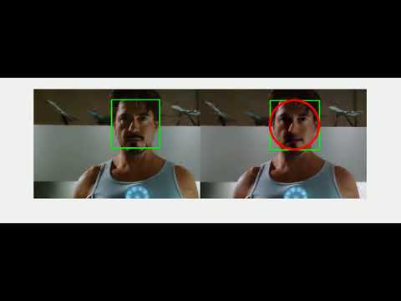
Detection Demo
Notes:
green rectangle is face region. red circle means the face is swapped by deepfake in this demo we can get 99% percent accuacy only one fram is wrong but haar classfier loss some

Slide 24
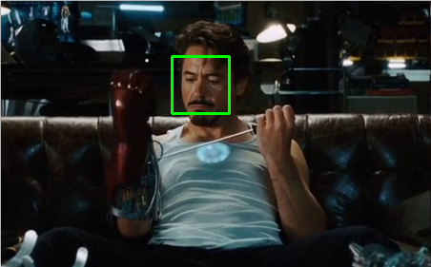

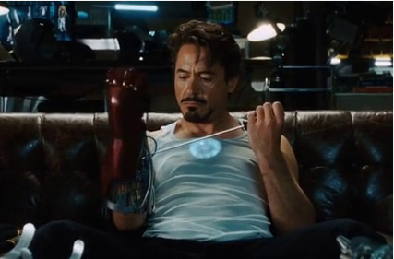
Blur detector
Face detector
Crop operation
Face
Background

Slide 25
Blur detector
Method 1 : Variance calculation

Slide 26
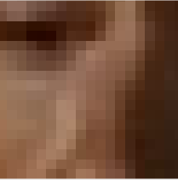

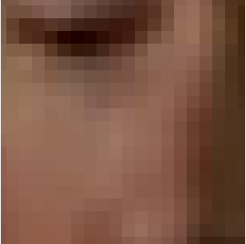
Blur detector
detail
Face region
Variance = 4.6230e-05
Variance = 2.7516e-05

Slide 27
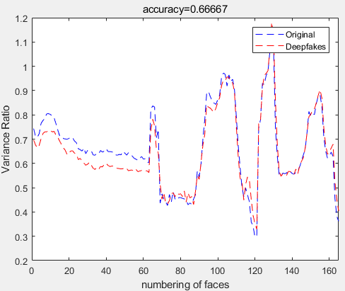
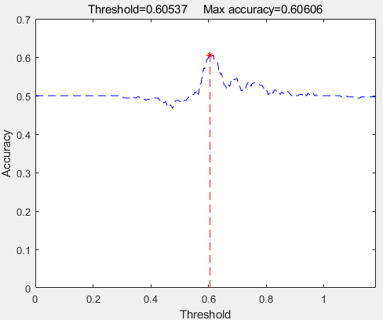
Blur detector
Work but not enough
Raw data
Acc = 0.66667
Acc = 0.60606

Slide 28
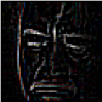
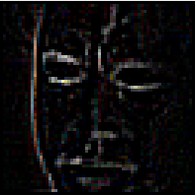
Blur detector
detail
Face region
Result of Laplacian operator
Variance = 1.4930e-04
Variance = 7.2018e-05

Slide 29
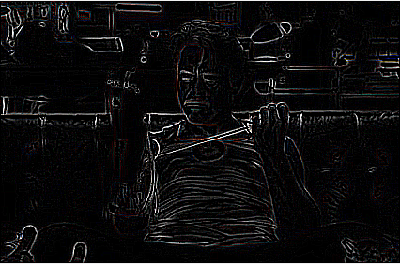
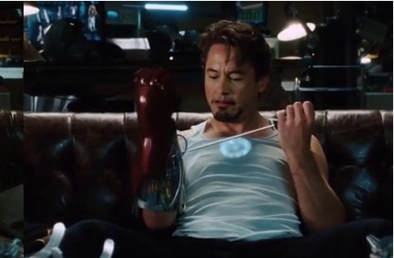
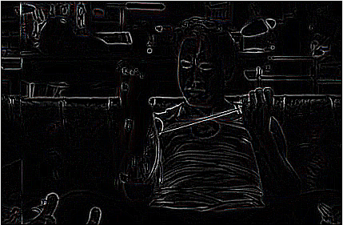
Blur detector
Background
Result of Laplacian operator
Variance = 8.3267e-05
Variance = 6.9656e-05

Slide 30
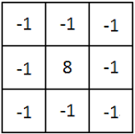
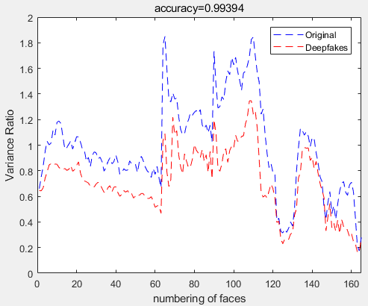
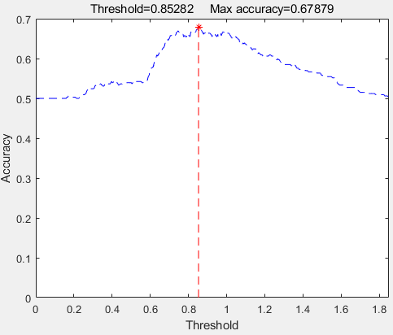
Blur detector
Great result
Laplacian operator with diagonals
Acc = 0.99394
Acc = 0.67879

Slide 31
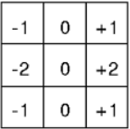
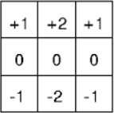
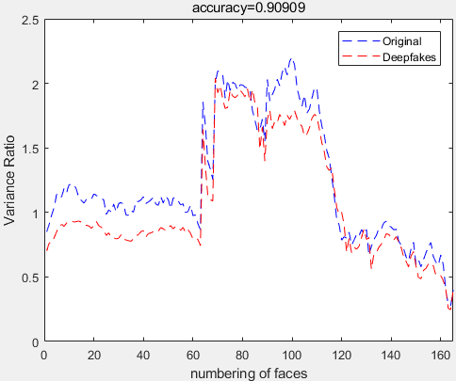
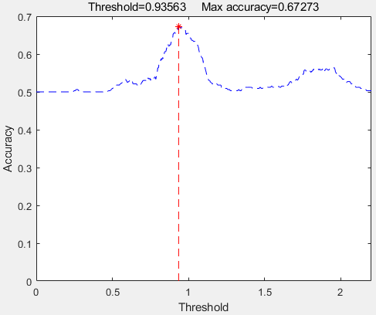
Blur detector
Slightly worse
Sobel operators
Acc = 0.90909
Acc = 0.67273

Slide 32
Blur detector
Method 2 : Skin detector

Slide 33
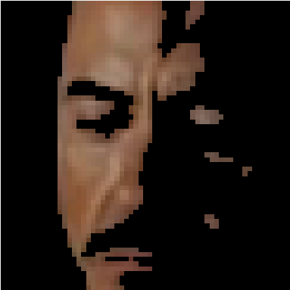
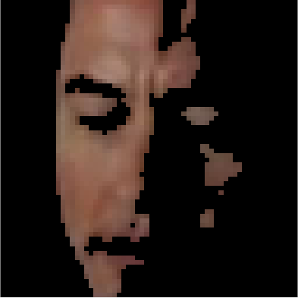
Blur detector
Skin detector
Uniform lighting:
R>95 & G>40 & B>20
& max(R,G,B)-min(R,G,B)>15
& abs(R-G)>15 & R>G & R>B
Sidelight:
R>220 & G>210 & B>170
& abs(R-G)<=15
& R>B & G>B
Face region
Skin part

Slide 34
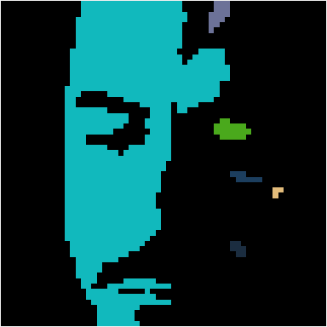
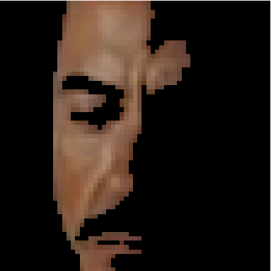
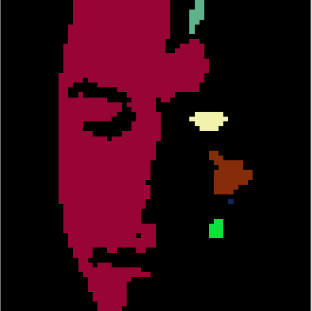
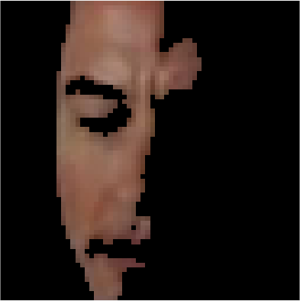
Blur detector
Face region
Skin part
Two-pass algorithm
Processed Skin part

Slide 35
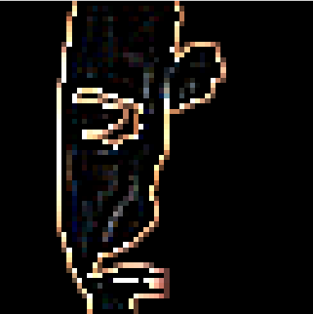
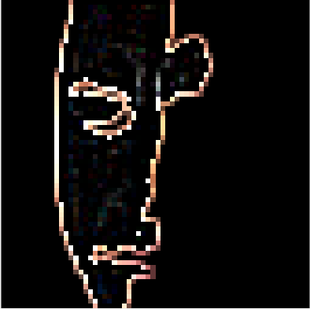
Blur detector
Processed Skin part
Processed Skin part with Laplacian operator
Variance = 0.0151
Variance = 0.4333
Variance = 0.0130
Variance = 0.3562

Slide 36
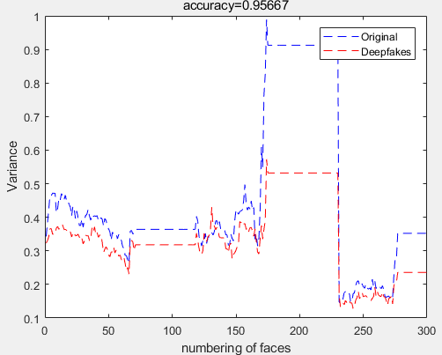
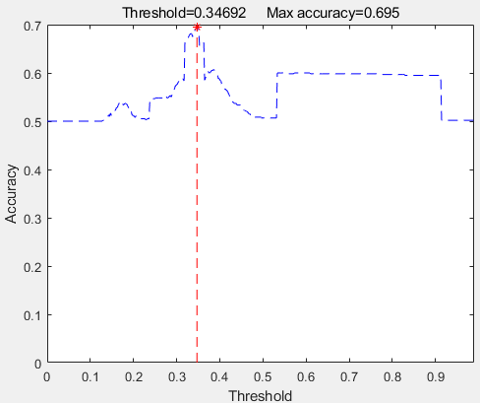
Blur detector
Good as well
skin detector + Laplacian operator with diagonals
Acc = 0.95667
Acc = 0.695

Slide 37
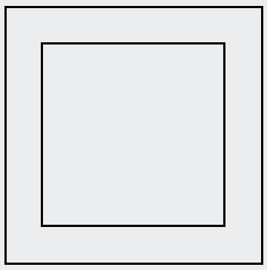
Blur detector
Improvement
1/8
1/8
Make the bounding box of face
Slightly smaller

Slide 38
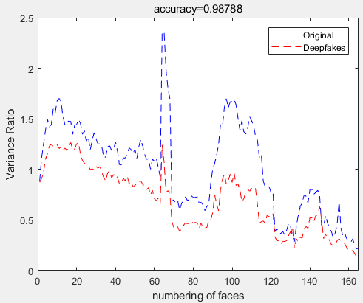

Blur detector
Better result
Laplacian operator with diagonals + adjusted size
Acc = 0.98788
Acc = 0.69697

Slide 39

Blur detector
Another example

Slide 40


Blur detector
Laplacian operator with diagonals + adjusted size
Acc = 0.98246
Acc = 0.87719

Slide 41


Blur detector
Better result
skin detector + Laplacian operator with diagonals
Acc = 0.9898
Acc = 0.89286

Slide 42
Blur detector
Conclusion
An effective way for Deepfake detection is to detect the face blur
We develop two type of detector: Variance calculation and Skin detector
There are two ways to compare the performance : Multiple images & Single image
The latter method has better accuracy while sometime the threshold can not be found

Slide 43


Thanks you !
References:
[1] Pan, X., Zhang, X., & Lyu, S. (2012, April). Exposing image splicing with inconsistent local noise variances. In Computational Photography (ICCP), 2012 IEEE International Conference on (pp. 1-10). IEEE.
[2] Viola, P., & Jones, M. (2001). Rapid object detection using a boosted cascade of simple features. In Computer Vision and Pattern Recognition, 2001. CVPR 2001. Proceedings of the 2001 IEEE Computer Society Conference on (Vol. 1, pp. I-I). IEEE.
[3] Korshunova, I., Shi, W., Dambre, J. and Theis, L. (2016). Fast Face-swap Using Convolutional Neural Networks. available at: arXiv:1611.09577.
[4] Pérez, P., Gangnet, M., & Blake, A. (2003). Poisson image editing. ACM Transactions on graphics (TOG), 22(3), 313-318.
[5]Pan, Xunyu, Xing Zhang, and Siwei Lyu. "Exposing image splicing with inconsistent local noise variances." Computational Photography (ICCP), 2012 IEEE International Conference on. IEEE, 2012.
[6]Farid, Hany. "Image forgery detection." IEEE Signal processing magazine 26.2 (2009): 16-25.
[7]Ng, Tian-Tsong, et al. "Physics-motivated features for distinguishing photographic images and computer graphics." Proceedings of the 13th annual ACM international conference on Multimedia. ACM, 2005.
[8]Menaga, V., K. Mohanaprakash, and G. Kalaiarasi. "Identification of Facial Retouching Using Supervised Deep Learning Algorithm." International Journal of Engineering and Management Research (IJEMR) 7.2 (2017): 233-236.
[9]Nixon, Mark S., and Alberto S. Aguado. Feature extraction & image processing for computer vision. Academic Press, 2012
.

